Slide 1
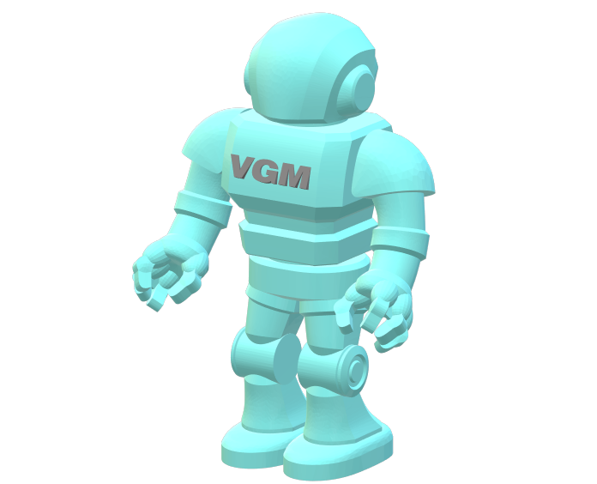
Vectric Gadget Man Easy Box Joint Version 3.3
May 2020

Slide 2

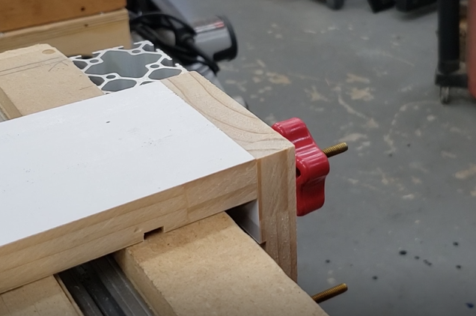
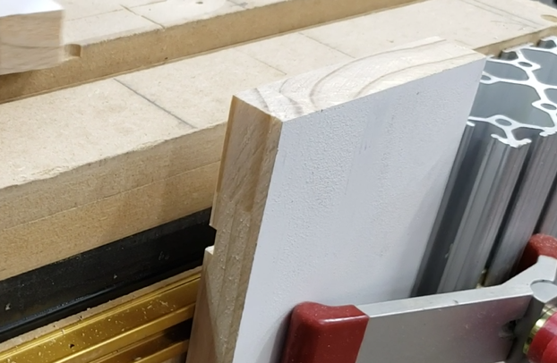
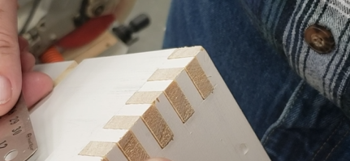
Box Joint Gadget Agenda
Job Setup
Running the Box Joint Gadget
Joint Setup
Making the Toolpaths
Testing the Fit
Please Note: This Gadget builds a Box-Joint by controlling the number of fingers and slots over the size of the finger and slot size. I find the best to use Odd finger count as shown here in the image above.

Slide 3
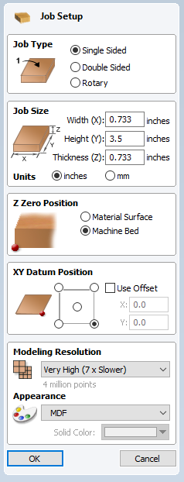
Box Joint Gadget Job Setup
Job Size – Width: Set to your material thickness
Job Type – Set to ‘Single Sided’
Milling operation is on the End of the material
Job Size – Height: Set to your material Width
Job Size – Units: Set to Your Units
Job Size – Thickness: Set to your material thickness
Z Zero Position – Set to ‘Your Style of Milling’
I use ‘Machine Bed’
XY Datum Position –Set to your Mill
I use the Lower Right on my Mill configuration

Slide 4
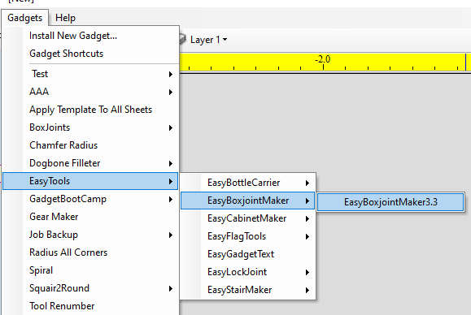
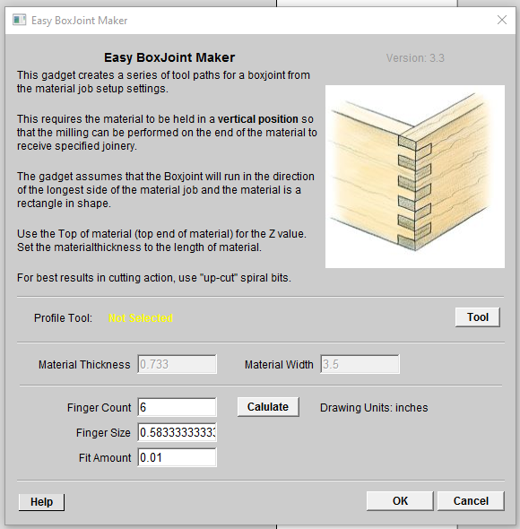
Box Joint Gadget Running the Box Joint Gadget
Version 10 or higher - Select Tool From The Tool Database
----------------------------
Version 9 or lower – Enter The Tool Diameter
Run Easy Box Joint Gadget

Slide 5
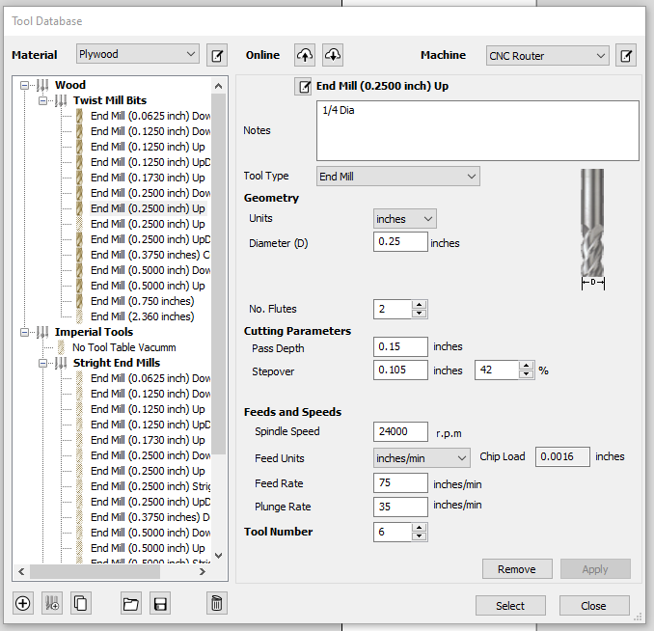
Box Joint Gadget Running the Box Joint Gadget
Select a Tool Diameter smaller or equal to the slot size

Slide 6
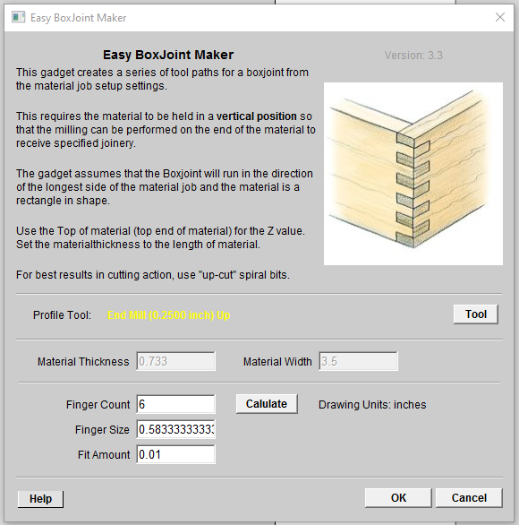
Box Joint Gadget Running the Box Joint Gadget
Displays the Tool Selected
Select the Calculate button to display the Finger size
Enter the number of fingers for the joint
Note: an Odd number Fingers will produce joins with one board with a top and bottom finger as shown in the image

Slide 7
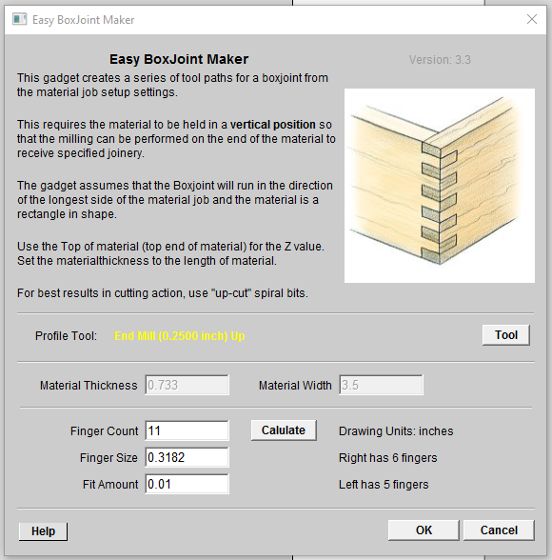
Box Joint Gadget Running the Box Joint Gadget
Calculations shows the Finger size of 0.3182 of an Inch
Select the OK button to build the geometry and toolpaths
Use the Fit Amount to adjust how lose or tight the joint will fit.

Slide 8
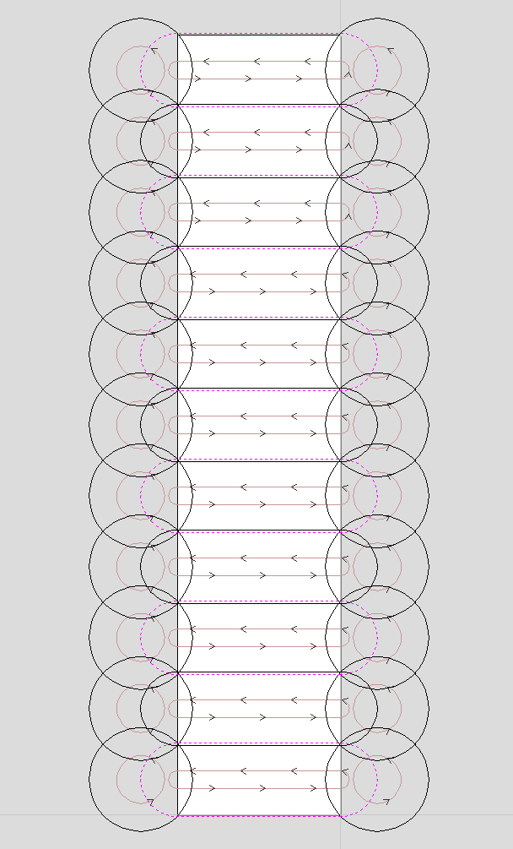
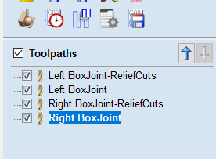
Box Joint Gadget Mill Setup
The geometry for the fingers and Relief cuts are drawn as shown here
Note: You can see the Fit adjustment is integrated in the geometry
Note: Right- and Left-Hand Toolpaths are built

Slide 9
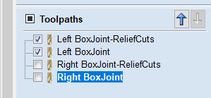
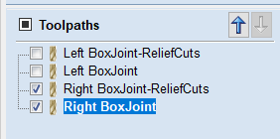
Box Joint Gadget Making the Toolpaths
Note: Select the Toolpaths that start with Left for the Left-Hand boards
Note: Select the Toolpaths that start with Right for the Right-Hand boards

Slide 10
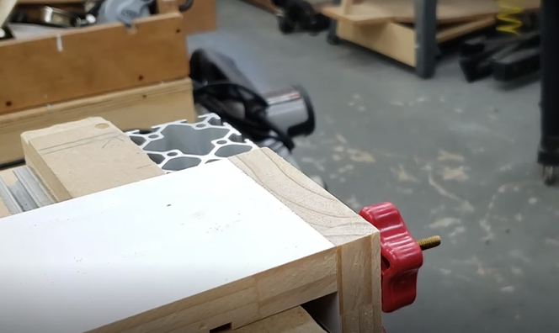
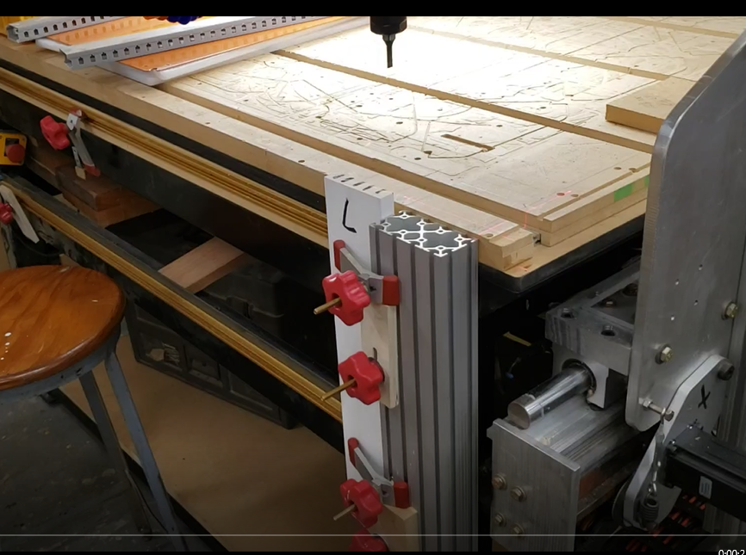
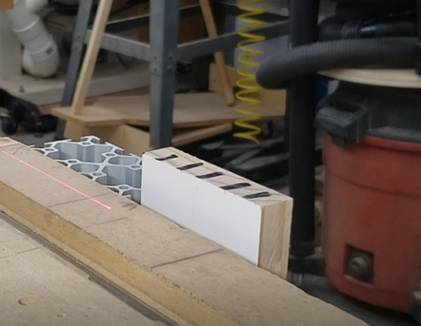
Box Joint Gadget Running the parts
Note: Use material to flush the top so it is projected above the mill table.
Note: Material is clamped to the front of the mill and is projected the thickness of the material above the mill table.
Note: Remove material as shown here.

Slide 11
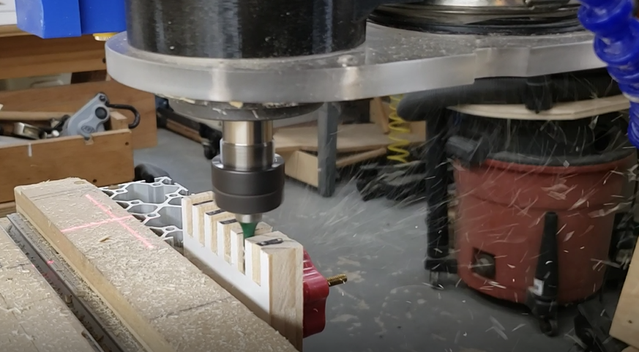
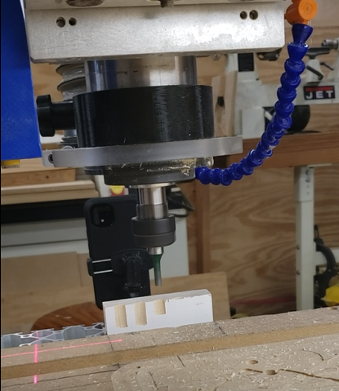
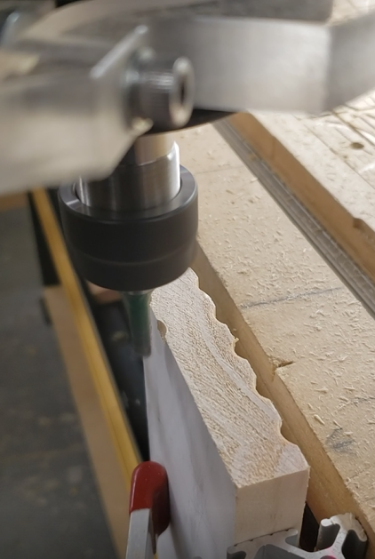
Box Joint Gadget Running the parts
Note: Fingers being milled.
Note: Relief cuts are made before cutting the fingers.

Slide 12
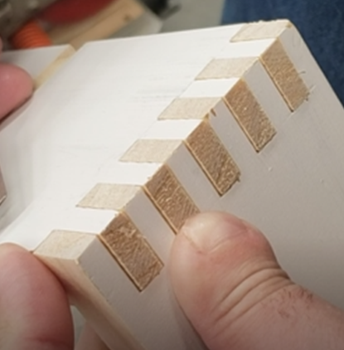
Box Joint Gadget Testing the Fit
Note: Fine tune the joint by adjusting the Fit Amount.

Slide 13


